Slide 1
Agents & Environment
Week2

Slide 2
Objective
By the end of this lesson, the learner should be able to understand the concept of intelligent agents, the role of environments in AI systems, and how intelligent agents interact with and adapt to their environments.

Slide 3
Learning Outcomes
Demonstrate an understanding of the fundamental concepts of intelligent agents including their characteristics and types
Categorize and analyze environments in the context of AI systems
Analyze how intelligent agents modify their behavior in response to changing environments.
Notes:
Students will demonstrate an understanding of the fundamental concepts of intelligent agents, including their characteristics and various types such as simple reflex agents, model-based reflex agents, goal-based agents, and utility-based agents. They will be able to distinguish between different types of intelligent agents and identify examples of intelligent agents in everyday life.
Students will be able to categorize and analyze environments in the context of AI, including fully observable, partially observable, deterministic, stochastic, episodic, and sequential environments. They will understand the implications of different environment types on the design and performance of intelligent agents, and apply this knowledge to classify given environments based on their characteristics.
Students will comprehend the concept of percepts and actions in intelligent agents, and how agents adapt to their environments through learning and decision-making. They will analyze case studies illustrating how intelligent agents modify their behavior in response to changing environments. Through group discussions, students will recognize the significance of adaptability in intelligent agents and its relevance to real-world applications.

Slide 4
Higher Education
Learn to BUILD MODELS (using differential equations, statistical probabilities, physical and computational simulations,) that we can use to EXPLAIN the Past, PREDICT the future, UNDERSTAND the subject, and CONTROL the world
In AI, we build models of THINKING,

Slide 5
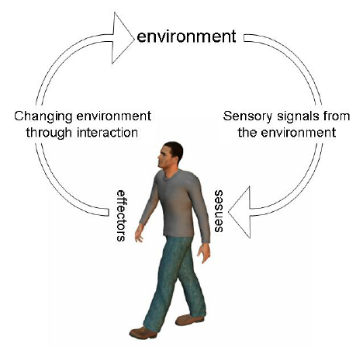
AI
Building machine models targeted at
THINKING
PERCEPTION
ACTION
In order to have a model, you MUST have a REPRESENTATION
AI is about building Methods, Algorithms, Representations that support the building of models that are intelligent ( i.e. facilitate an understanding of thinking, perception, and action)

Slide 6
Overview: Fundamental AI Concepts
Intelligent Agents: entities that perceive their environment and take actions to achieve goals. Intelligent agents make decisions based on their observations, adapting to changing situations.
Problem solving: involves finding solutions to complex issues. Search algorithms, heuristics, and optimization techniques are essential components of problem-solving in AI.
Knowledge Representation and Reasoning: involves organizing information in a way that AI systems can utilize. Reasoning allows AI systems to draw conclusions and make decisions based on the represented knowledge.
Machine Learning: a subset of AI that focuses on creating algorithms and models that enable computers to learn from data and improve their performance over time. This includes supervised learning, unsupervised learning, and reinforcement learning.
Neural Networks and Deep Learning: computational models inspired by the human brain. Deep learning, a subset of machine learning, involves training deep neural networks to perform tasks such as image recognition and natural language processing.
Natural Language Processing (NLP): enables computers to understand, interpret, and generate human language. It encompasses tasks like sentiment analysis, language translation, and speech recognition.

Slide 7
AI Concepts
Search Algorithms: are used to navigate through problem spaces and find solutions efficiently. Algorithms like depth-first search, breadth-first search, and A* are commonly employed in AI
Expert Systems: Expert systems mimic the decision-making capabilities of a human expert in a specific domain. They use rule-based systems and knowledge bases to provide expert-level advice.
Computer vision: involves enabling machines to interpret and understand visual information from the world, such as image and video recognition
Robotics: involves the design, creation, and operation of robots to perform tasks autonomously. It integrates computer vision, machine learning, and control systems.
Ethics in AI: address the responsible development and use of AI technologies, including issues related to bias, transparency, accountability, and the societal impact of AI.

Slide 8
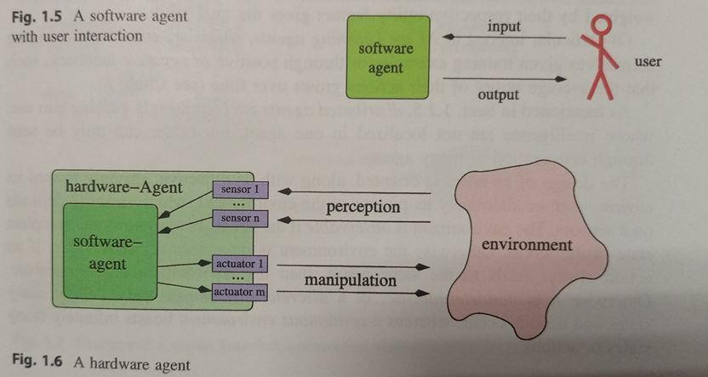
Agents
An agent is anything that can be viewed as perceiving its environment through sensors and acting upon that environment through actuators
Human agent: eyes, ears, and other organs for sensors; hands, legs, mouth, and other body parts for actuators
Hardware Agents (autonomous Robots) : cameras and infrared range finders for sensors;various motors for actuators
Software Agents: comprise a program that calculates a result from user input

Slide 9
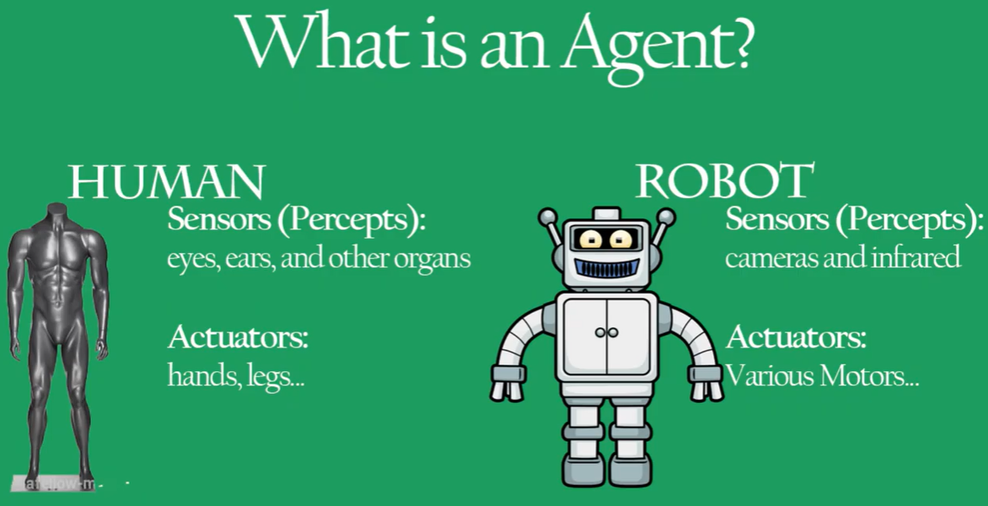

Slide 10
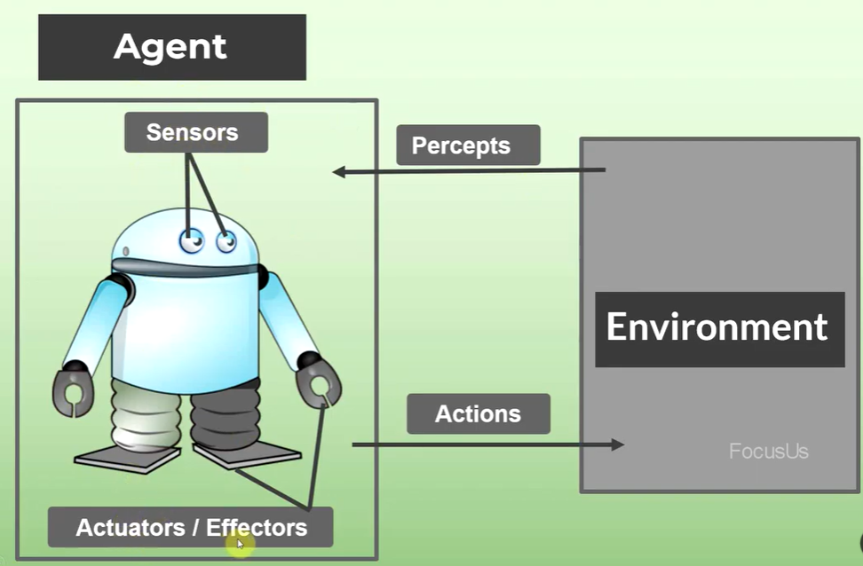

Slide 11
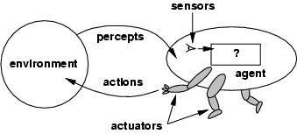
Agents and environments
The agent function maps from percept histories to actions: [f: P* → A] The agent program runs on the physical architecture to produce f agent = architecture + program
Sensors: What detects the changes and events in the environment
Actuators/ Effectors: Movable parts of an Agent
Perception: a way in which something is understood or interpreted.

Slide 12
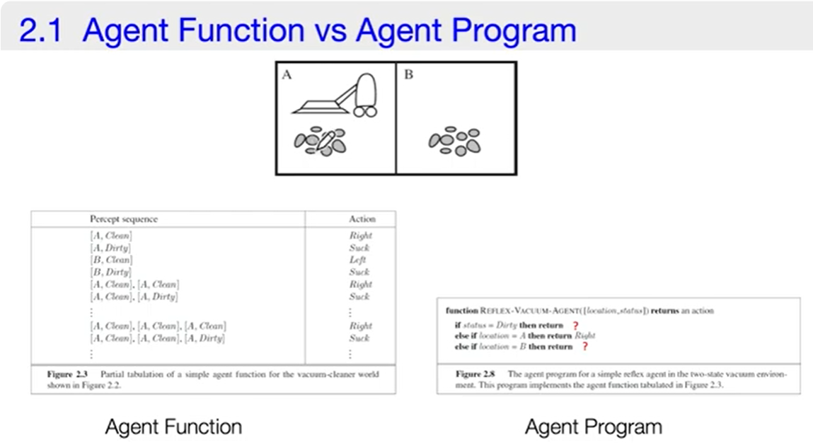
Vacuum-cleaner Robot

Slide 13
Intelligent Agents
An intelligent agent is an autonomous entity which act upon an environment using sensors and actuators for achieving goals.
An intelligent agent may learn from the environment to achieve their goals. A thermostat is an example of an intelligent agent.
Rule 1: An AI agent must have the ability to perceive the environment.
Rule 2: The observation must be used to make decisions.
Rule 3: Decision should result in an action.
Rule 4: The action taken by an AI agent must be a rational action.

Slide 14
Rational agents
A rational agent is an agent which has clear preference, models uncertainty, and acts in a way to maximize its performance measure with all possible actions.
An agent should strive to "do the right thing", based on what it can perceive and the actions it can perform. The right action is the one that will cause the agent to be most successful
Performance measure: An objective criterion for success of an agent's behavior in the environment
E.g., performance measure of a vacuum-cleaner agent could be amount of dirt cleaned up, amount of time taken, amount of electricity consumed, amount of noise generated, etc.

Slide 15
Rational agents
Rational Agent: For each possible percept sequence, a rational agent should select an action that is expected to maximize its performance measure, given the evidence provided by the percept sequence and whatever built-in knowledge the agent has.

Slide 16
What’s involved in Intelligence? Intelligent agents
Ability to interact with the real world
to perceive, understand, and act
e.g., speech recognition and understanding and synthesis
e.g., image understanding
e.g., ability to take actions, have an effect
Knowledge Representation, Reasoning and Planning
modeling the external world, given input
solving new problems, planning and making decisions
ability to deal with unexpected problems, uncertainties
Learning and Adaptation
we are continuously learning and adapting
our internal models are always being “updated”
e.g. a baby learning to categorize and recognize animals

Slide 17
Implementing agents
Table look-ups
Autonomy
All actions are completely specified
no need in sensing, no autonomy
example: Monkey and the banana
Structure of an agent
agent = architecture + program
Agent types
medical diagnosis
Satellite image analysis system
part-picking robot
Interactive English tutor
cooking agent
taxi driver

Slide 18
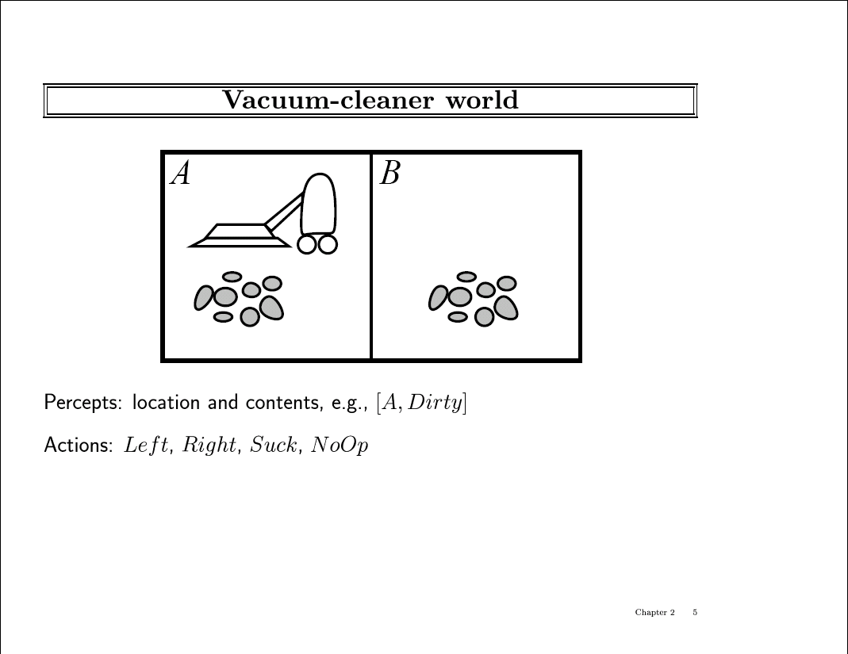

Slide 19
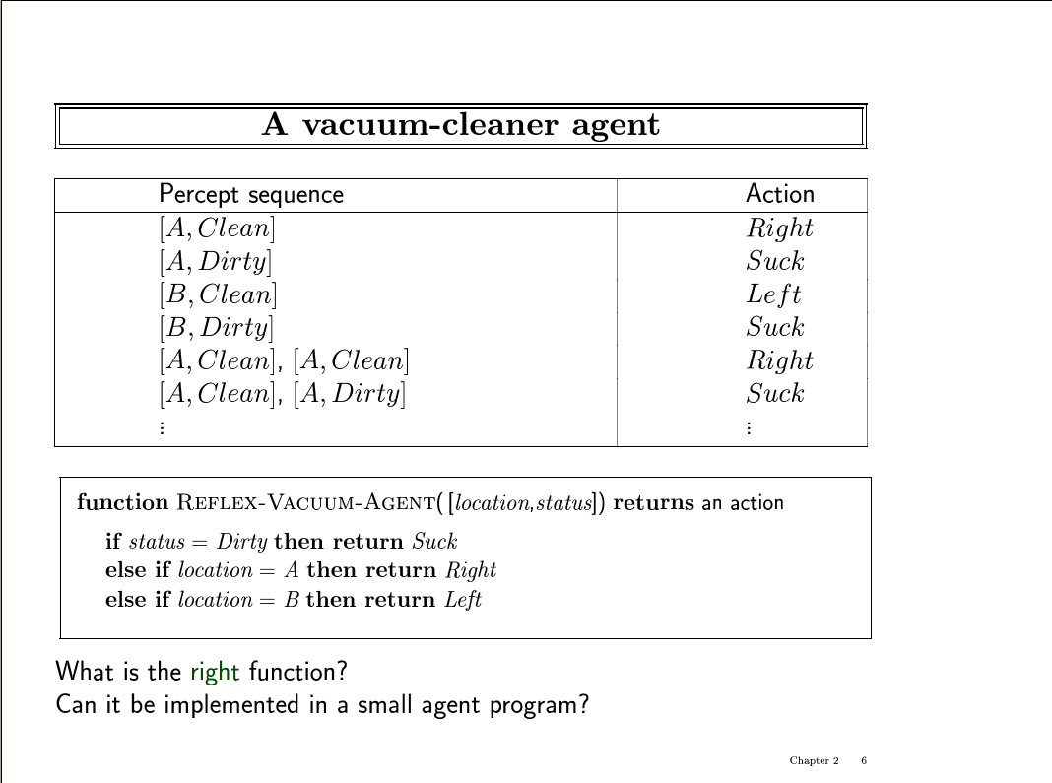

Slide 20
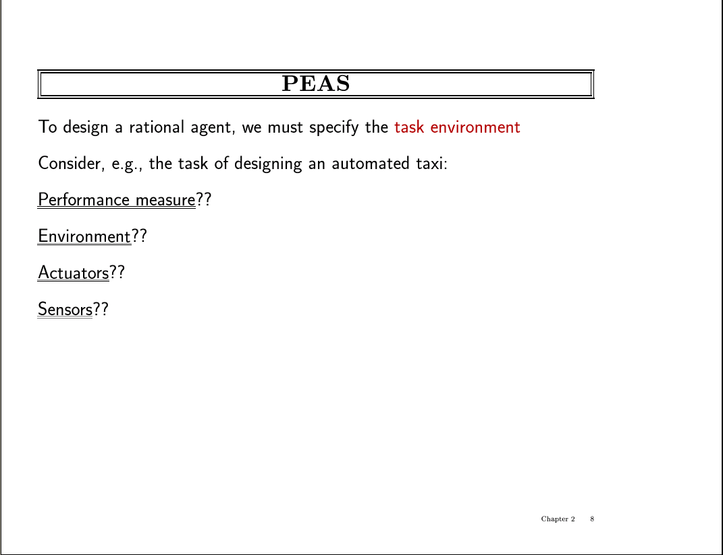

Slide 21
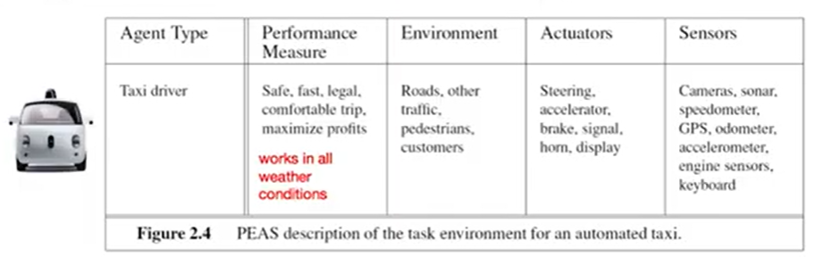
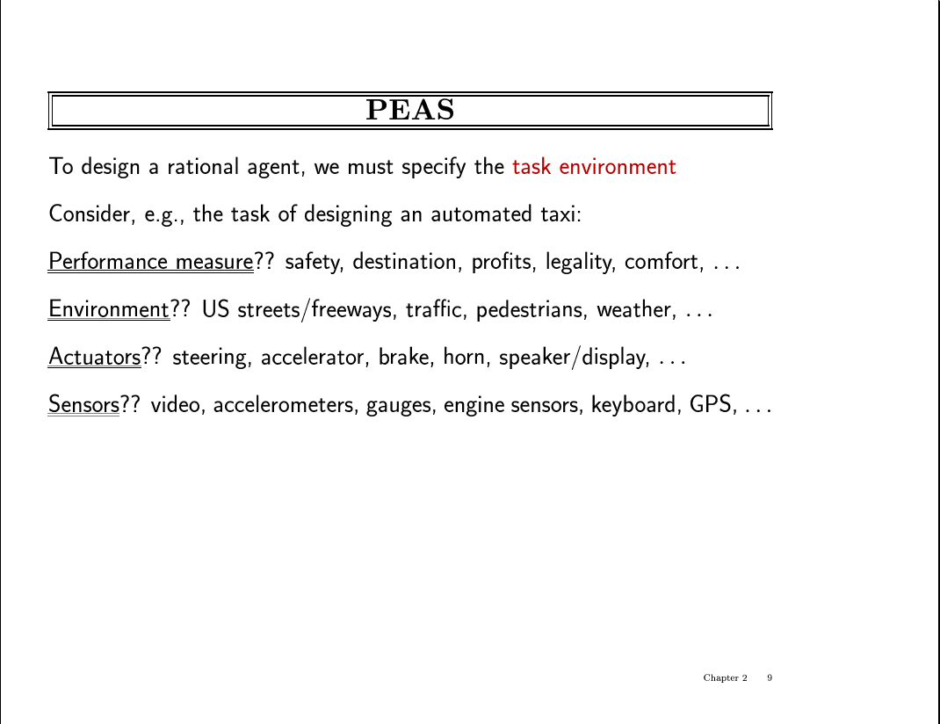
Performance measure is based on the IMPACT of Agent to the Environment , not the Agent itself
Notes:
In designing an agent, the first step must always be to specify the task environment as fully as possible.
The Task environment is a combination of 4 things : PEAS

Slide 22
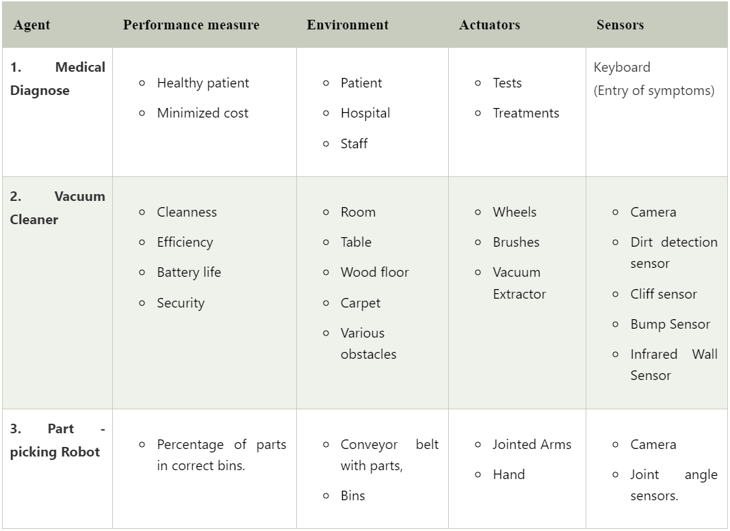

Slide 23
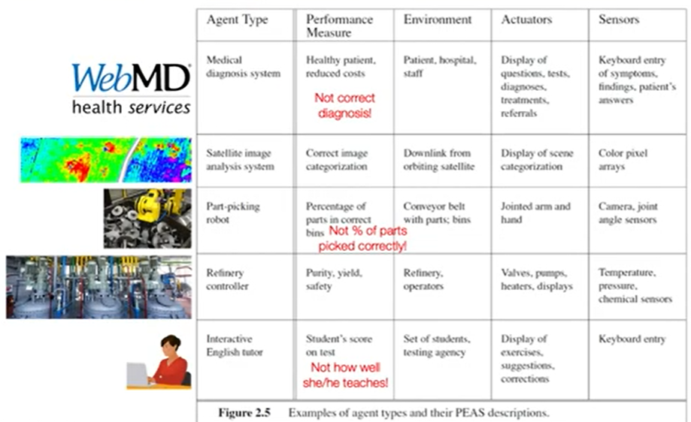
More Examples on Specifying a Task Environment

Slide 24
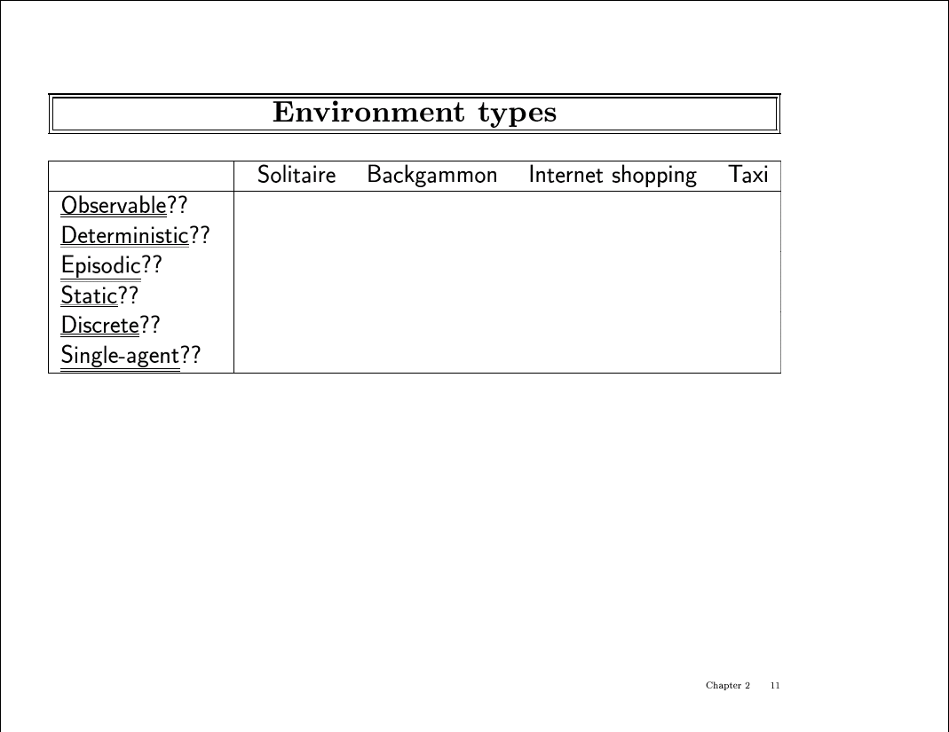

Slide 25
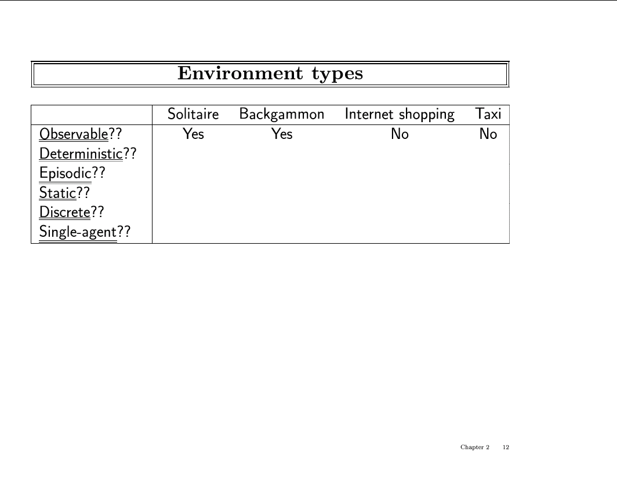

Slide 26
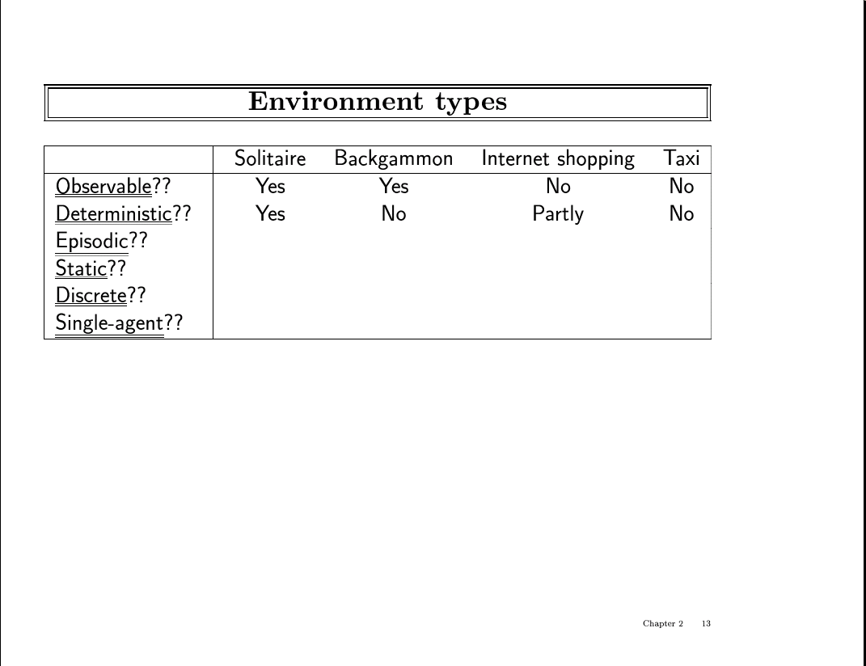

Slide 27
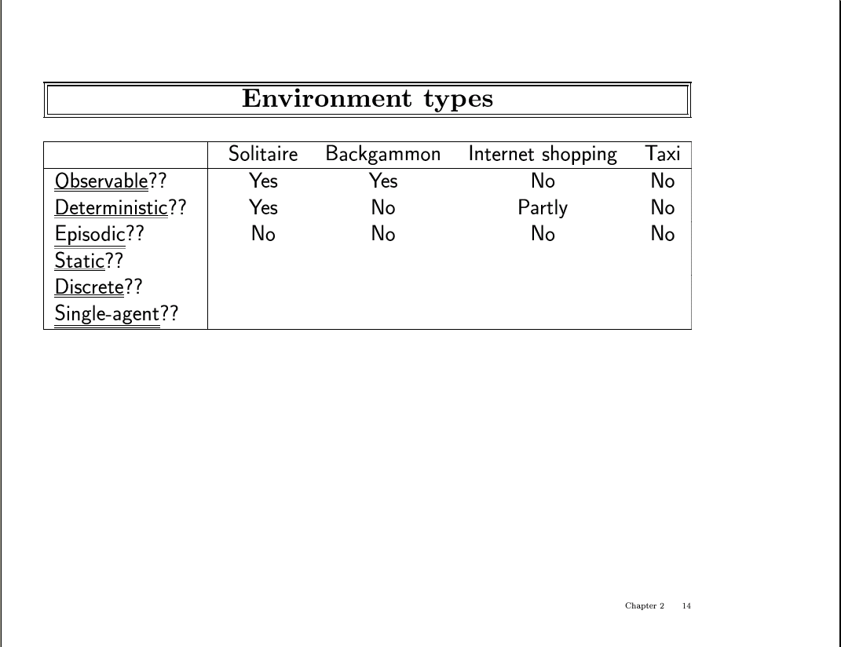

Slide 28
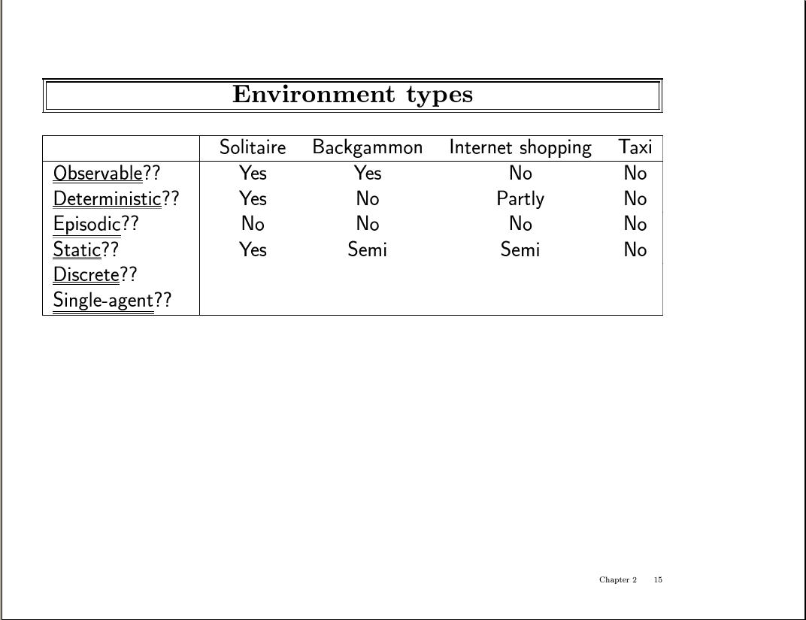

Slide 29
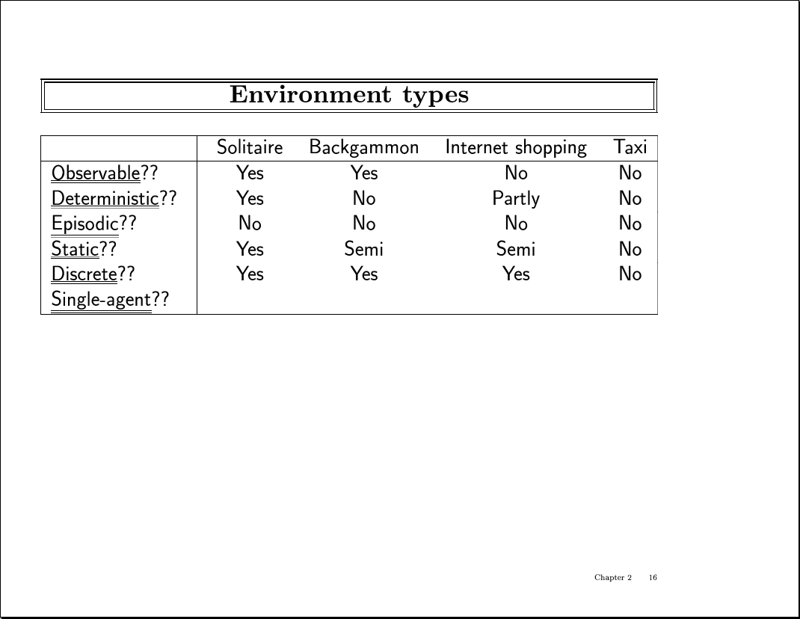

Slide 30
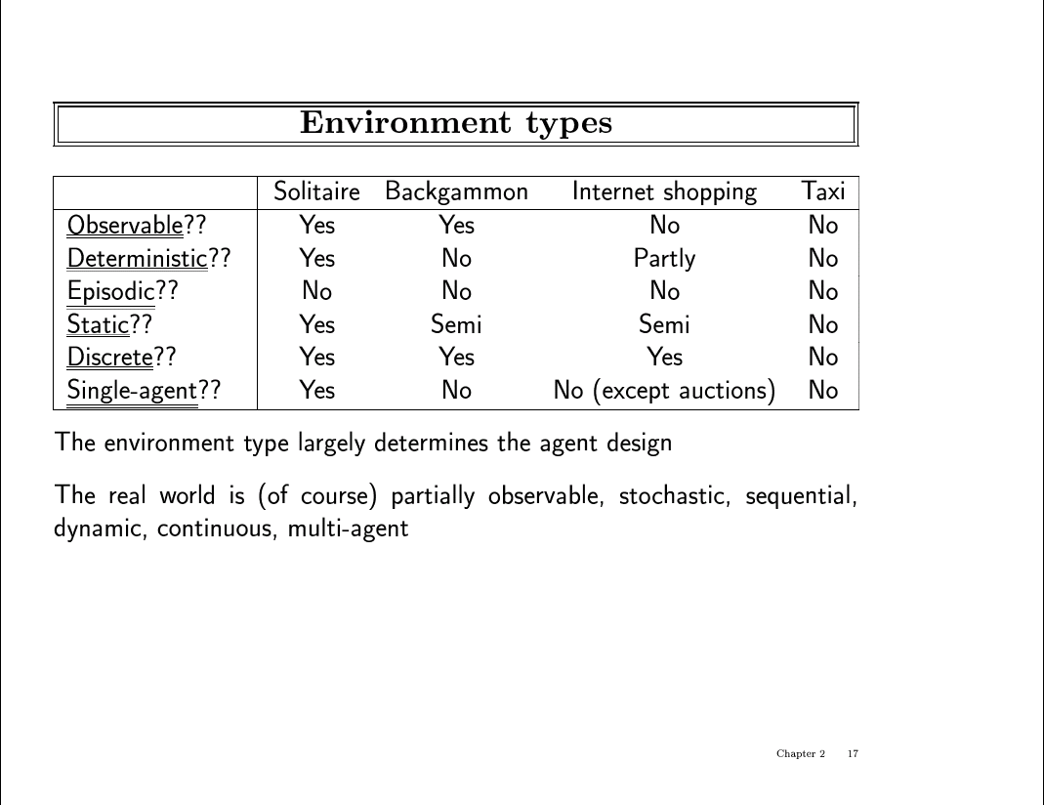

Slide 31
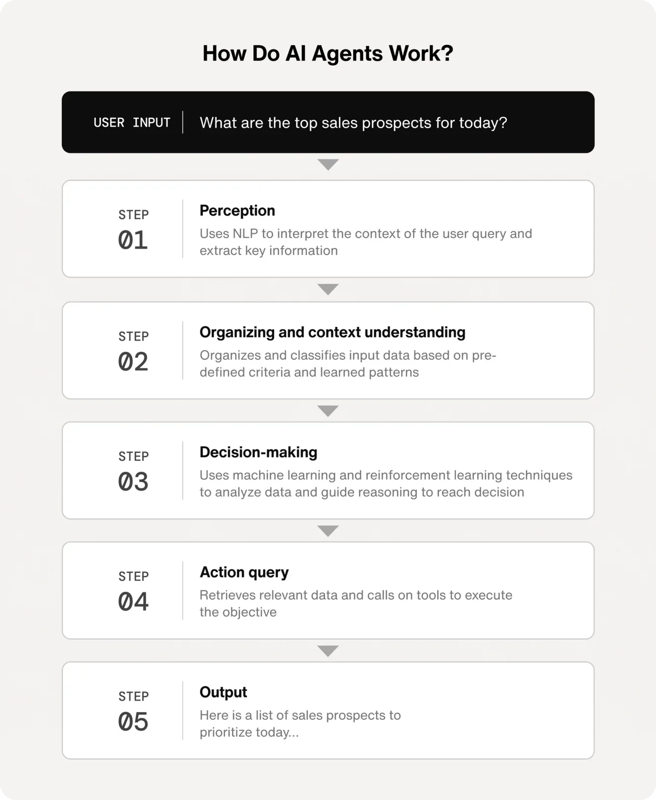

Slide 32
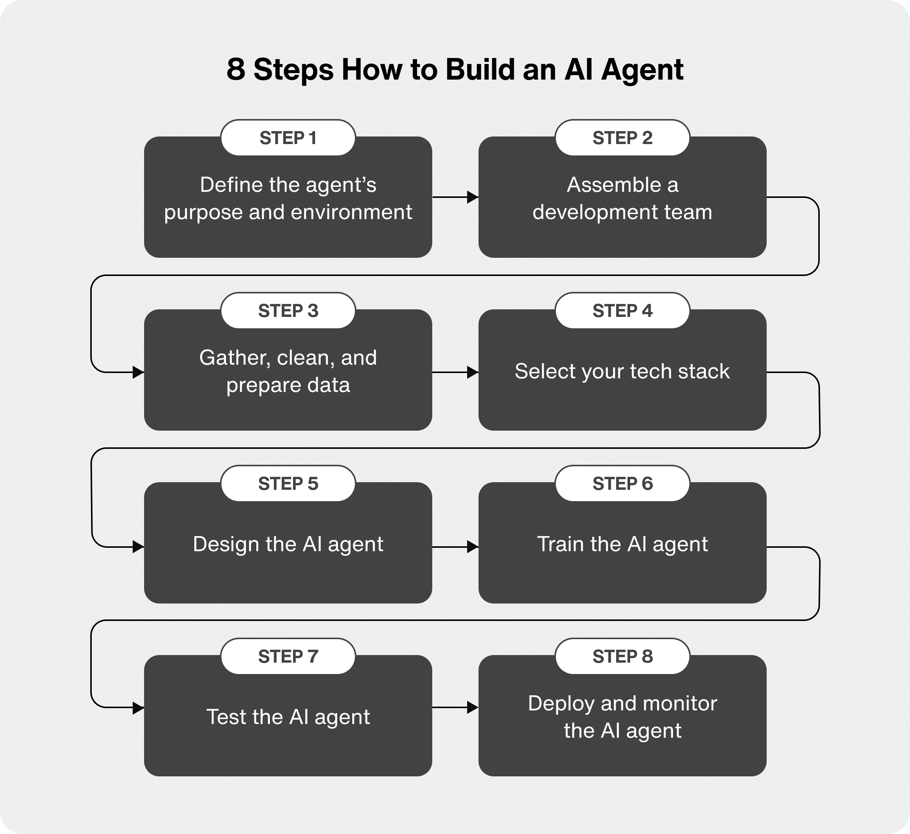
Notes:
Step 1: Define the agent’s purpose and environment
The first step is to decide what you want your AI agent to do. For example, an AI for a customer service agent could handle customer inquiries and troubleshoot issues, while an ecommerce AI agent could make personalized product recommendations.
After you’ve determined the agent’s tasks and functions, you can identify the environment it will operate within. The environment is made up of all the software systems, databases, context, and spaces the agent has been programmed to perceive and interact with in pursuit of a defined objective.
Once integrated with these various systems and components, the AI agent can use any of the available tools and knowledge sources at its disposal to autonomously achieve its objective.
Step 2: Assemble a development team
Even though AI agents are autonomous in their decision-making, they still require humans to define their goals and environment, as well as train, deploy, and maintain them. You’ll want to enlist the help of an expert team that’s responsible for managing your AI agent project at every stage.
Here’s a list of roles you’ll likely need on your team:
Machine learning engineer
Data scientist
Software engineer
UI/UX engineer
DevOps engineer
Step 3: Gather and preprocess training data
AI agents must be trained on large quantities of high-quality data to accurately understand and process user inputs. If the data is inaccurate or low quality, the agent will learn the wrong things and perform poorly. Basically, the agent’s decision-making depends on the quality of its training data.
The key is to gather any and all data that’s accurate and relevant to the agent’s specific use case(s). This data can come from several sources:
Internal business data: This can include sales records, financial reports, product documentation, and customer information, such as text transcripts of chat logs or support tickets.
External data: This is data that you can obtain by purchasing datasets, partnering with data providers, or using publicly available data.
User-generated data: This includes social media posts, product reviews, website interactions, and other data directly from customers or users.
After collecting your data, it will need to be cleaned and prepared before it’s used for training. This involves removing any irrelevant, incomplete, or incorrect data to ensure accuracy and consistency across the dataset.
For example, cleaning data can include tasks like:
Dealing with missing values
Detecting outliers
Fixing typos in text transcripts
Labeling data with tags or metadata so the AI understands its context and purpose
Step 4: Choose your tech stack
Every AI agent is unique, so there’s no one-size-fits-all tech stack. Depending on the agent’s use case and operating environment, you’ll select from various AI components that can include:
Machine learning model: The core component of an AI agent. Machine learning determines the extent to which it can learn from data and interactions and perform tasks.
Natural language processing: Enables the agent to understand and respond using human language.
Computer vision: Enables the AI agent to perceive and understand the world in a visual way, such as identifying and locating objects or tracking motion.
Robotic process automation: This component lets the agent automate repetitive processes in a digital or physical environment.
AI agent architecture
Agentic AI systems are made up of multiple interconnected components that work together to enable the autonomous decision-making processes of AI agents. This modular architecture allows for separate specialized components to be created, combined, and adapted to different tasks that function together.
The key components of AI agent architecture include:
Profiling module: This helps define the AI agent’s role and function within a specific context, and influences how the agent stores information and strategizes.
Memory module: AI agents can store and recall past interactions using short-term memory for immediate tasks, and long-term memory for storing learned experiences. Memory can be stored in databases, natural language, and other formats.
Planning module: This module enables the AI agent to plan actions and tackle complex tasks. The agent can plan using feedback, which adjusts its strategy based on signals from the environment, humans, or its models. It can also plan without feedback, which involves breaking complex tasks into smaller, manageable steps to achieve a goal.
Action module: This translates the agent’s decisions into actions. These can be simple action targets like completing tasks, making API calls, or engaging users in conversation, or action strategies that involve memory, multi-round interactions, and adjustments based on feedback.

Slide 33
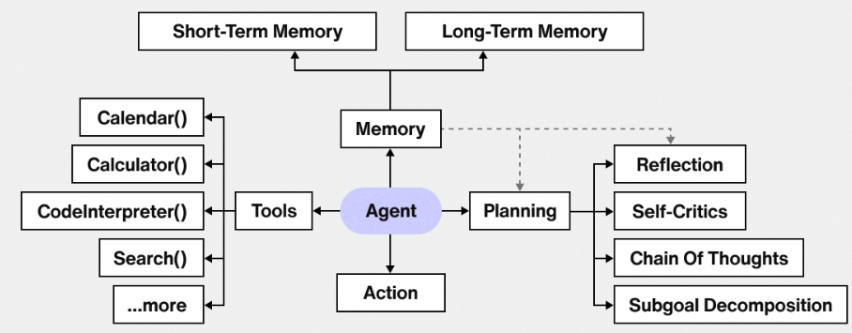

Slide 34
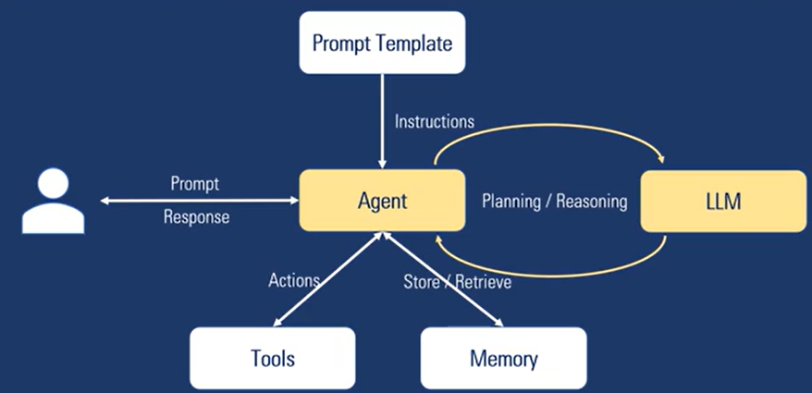
AI Agent Architecture

Slide 35
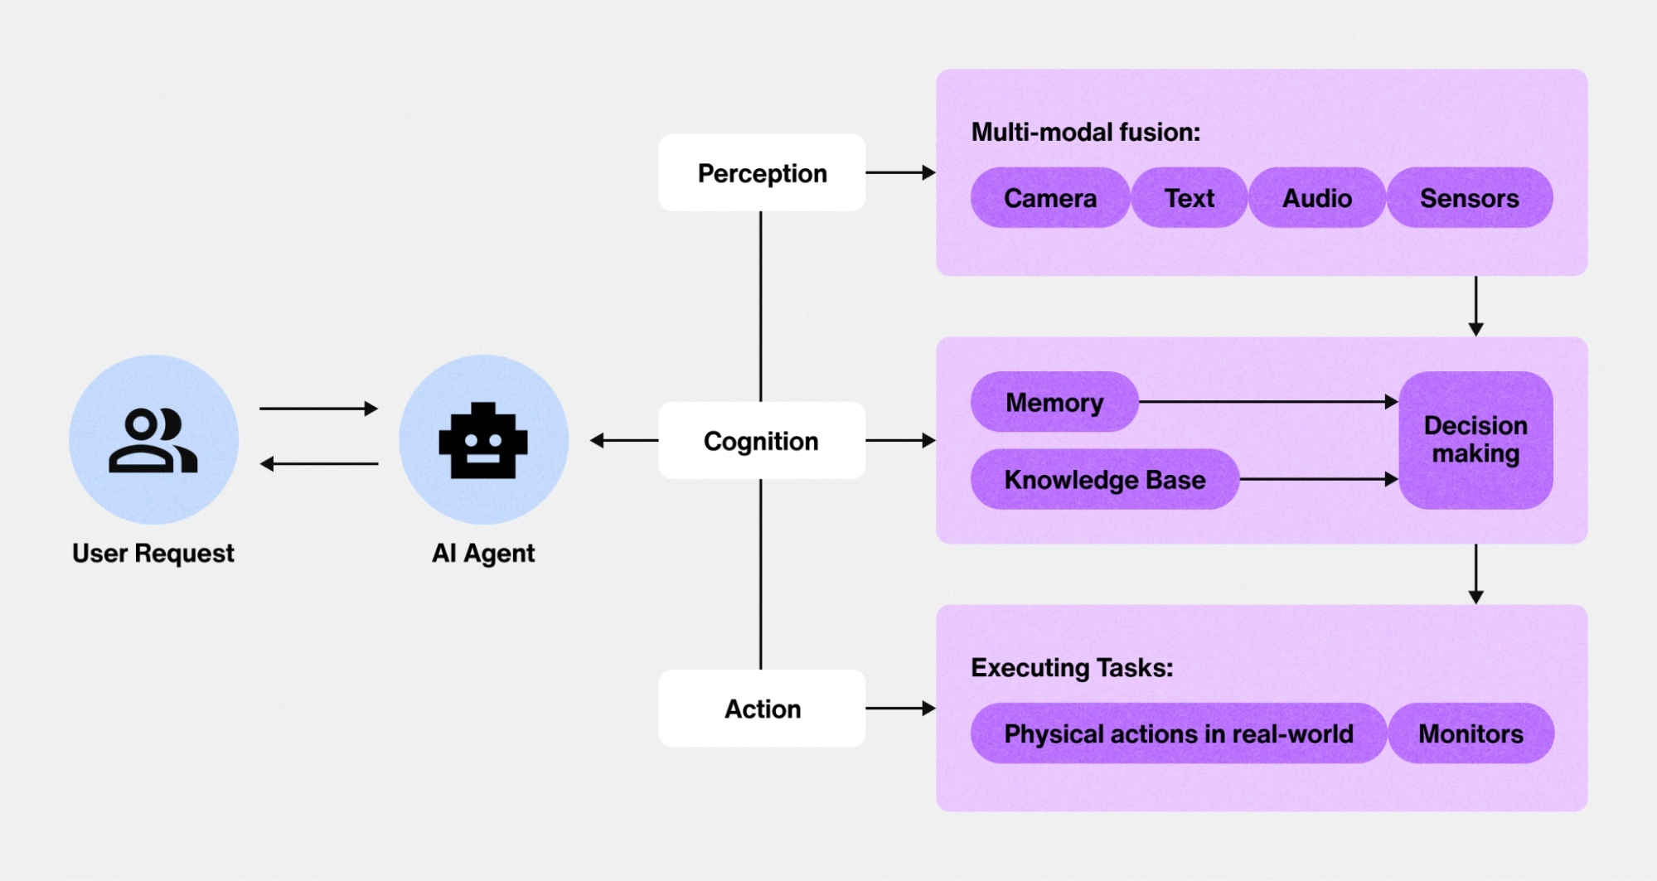
AI Agent Architecture

Slide 36
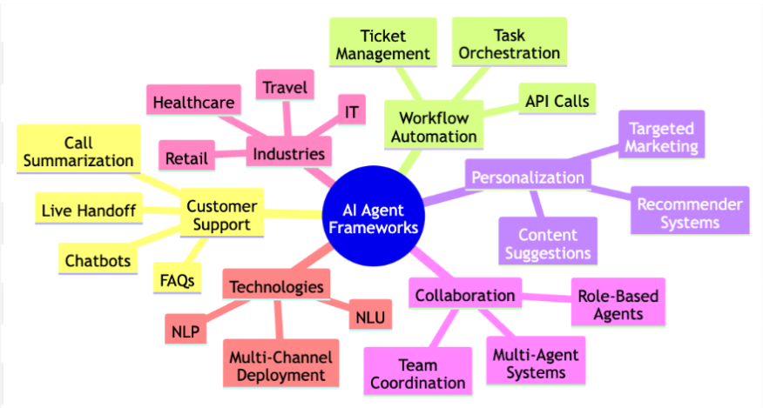

Slide 37
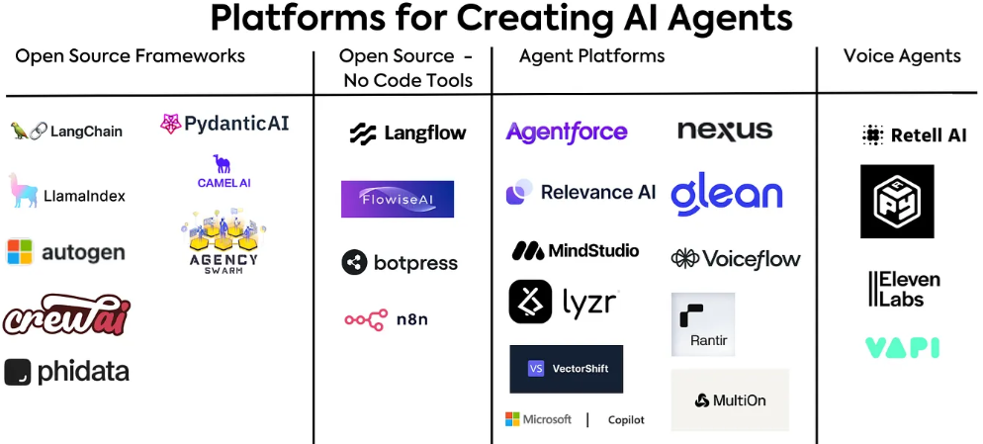
Notes:
Open Source Frameworks
LangChain : LangChain is a composable framework to build with LLMs.
LlamaIndex: LlamaIndex is a simple, flexible data framework for connecting custom data sources to large language models (LLMs).
AutoGen by Microsoft : AutoGen Studio 2.0 is an advanced AI development tool from Microsoft, designed for developers of all skill levels to create and control AI agents and workflows.
CrewAI : CrewAI is a multi-agent platform that streamlines workflows across industries using powerful AI agents. It allows users to build and deploy automated workflows with ease, enhancing business efficiency and growth.
Phidata: An open-source platform to build, ship and monitor agentic systems.
Pydantic Agents: PydanticAI is a Python agent framework designed to make it less painful to build production grade applications with Generative AI.
CamelAI : CAMEL-AI.org is the 1st LLM multi-agent framework and an open-source community dedicated to finding the scaling law of agents.
Agency Swarm : An open source agent orchestration framework built on top of the latest OpenAI Assistants API.
Open AI Swarm : Swarm is currently an experimental sample framework intended to explore ergonomic interfaces for multi-agent systems.

Slide 38
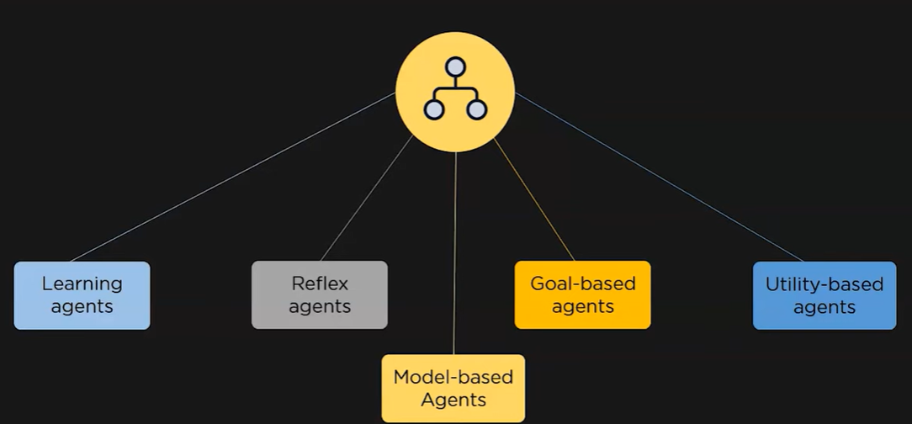
Types of Agents
Notes:
Learning Agents: learns from its past experience. Used in gaming.

Slide 39
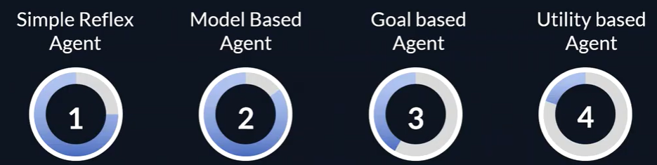
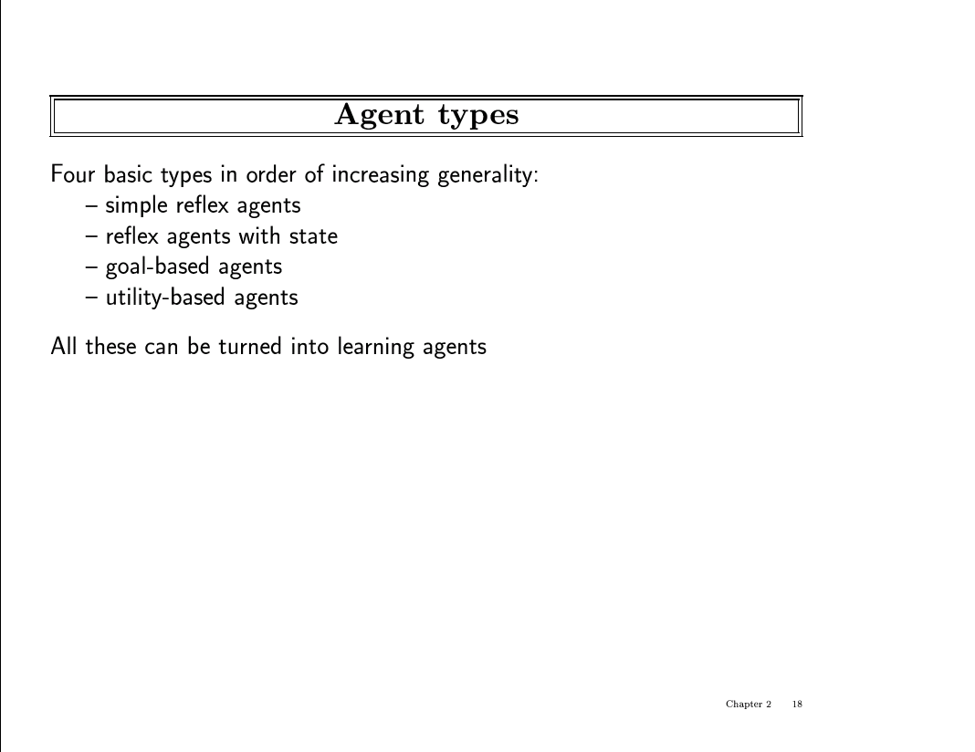

Slide 40
Agent types
Example: Taxi driver
Simple reflex
If car-in-front-is-breaking then initiate-breaking
Agents that keep track of the world
If car-in-front-is-breaking and on fwy then initiate-breaking
needs internal state
goal-based
If car-in-front-is-breaking and needs to get to hospital then go to adjacent lane and plan
search and planning
utility-based
If car-in-front-is-breaking and on freeway and needs to get to hospital alive then search of a way to get to the hospital that will make your passengers happy.
Needs utility function that map a state to a real function (am I happy?)

Slide 41
Agent Examples
An agent to help me review my emails and create tasks on a digital to do list based on the highest priority emails that come in
An agent that uses weather data and other information to decide when to water my garden and how long to water it for.
An agent that could respond to customers reporting bugs and automatically gathering missing information and seek clarification on confusing parts of a bug report and then route the bug to the appropriate team to resolve.
A travel planning agent that takes my preferences and needs to account, researches things like destinations and hotels and even activities, and then suggests an itinerary for me and use a collaborating agent to book everything all in one shot

Slide 42
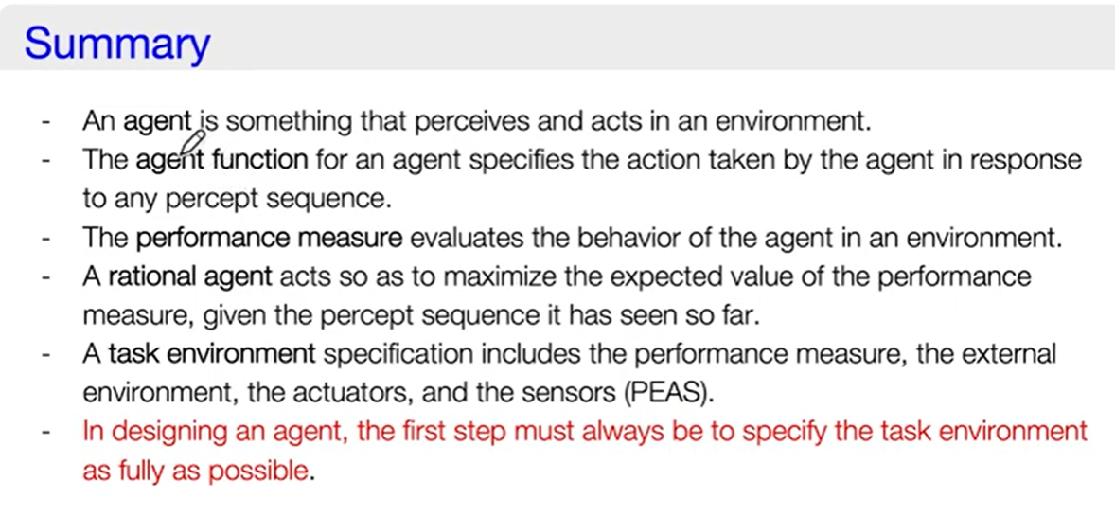

Slide 43
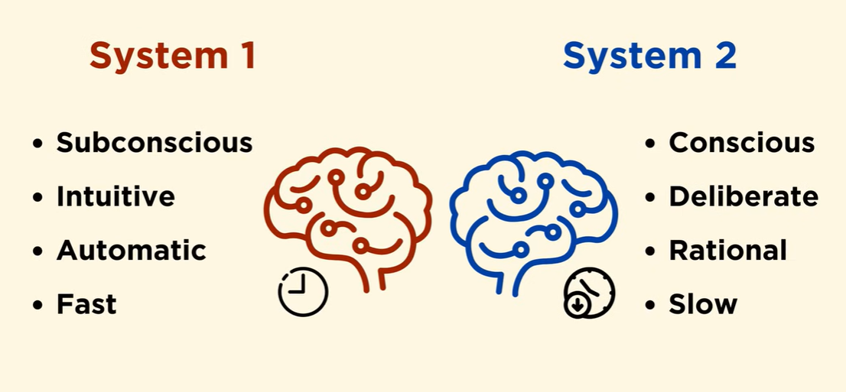

Slide 44
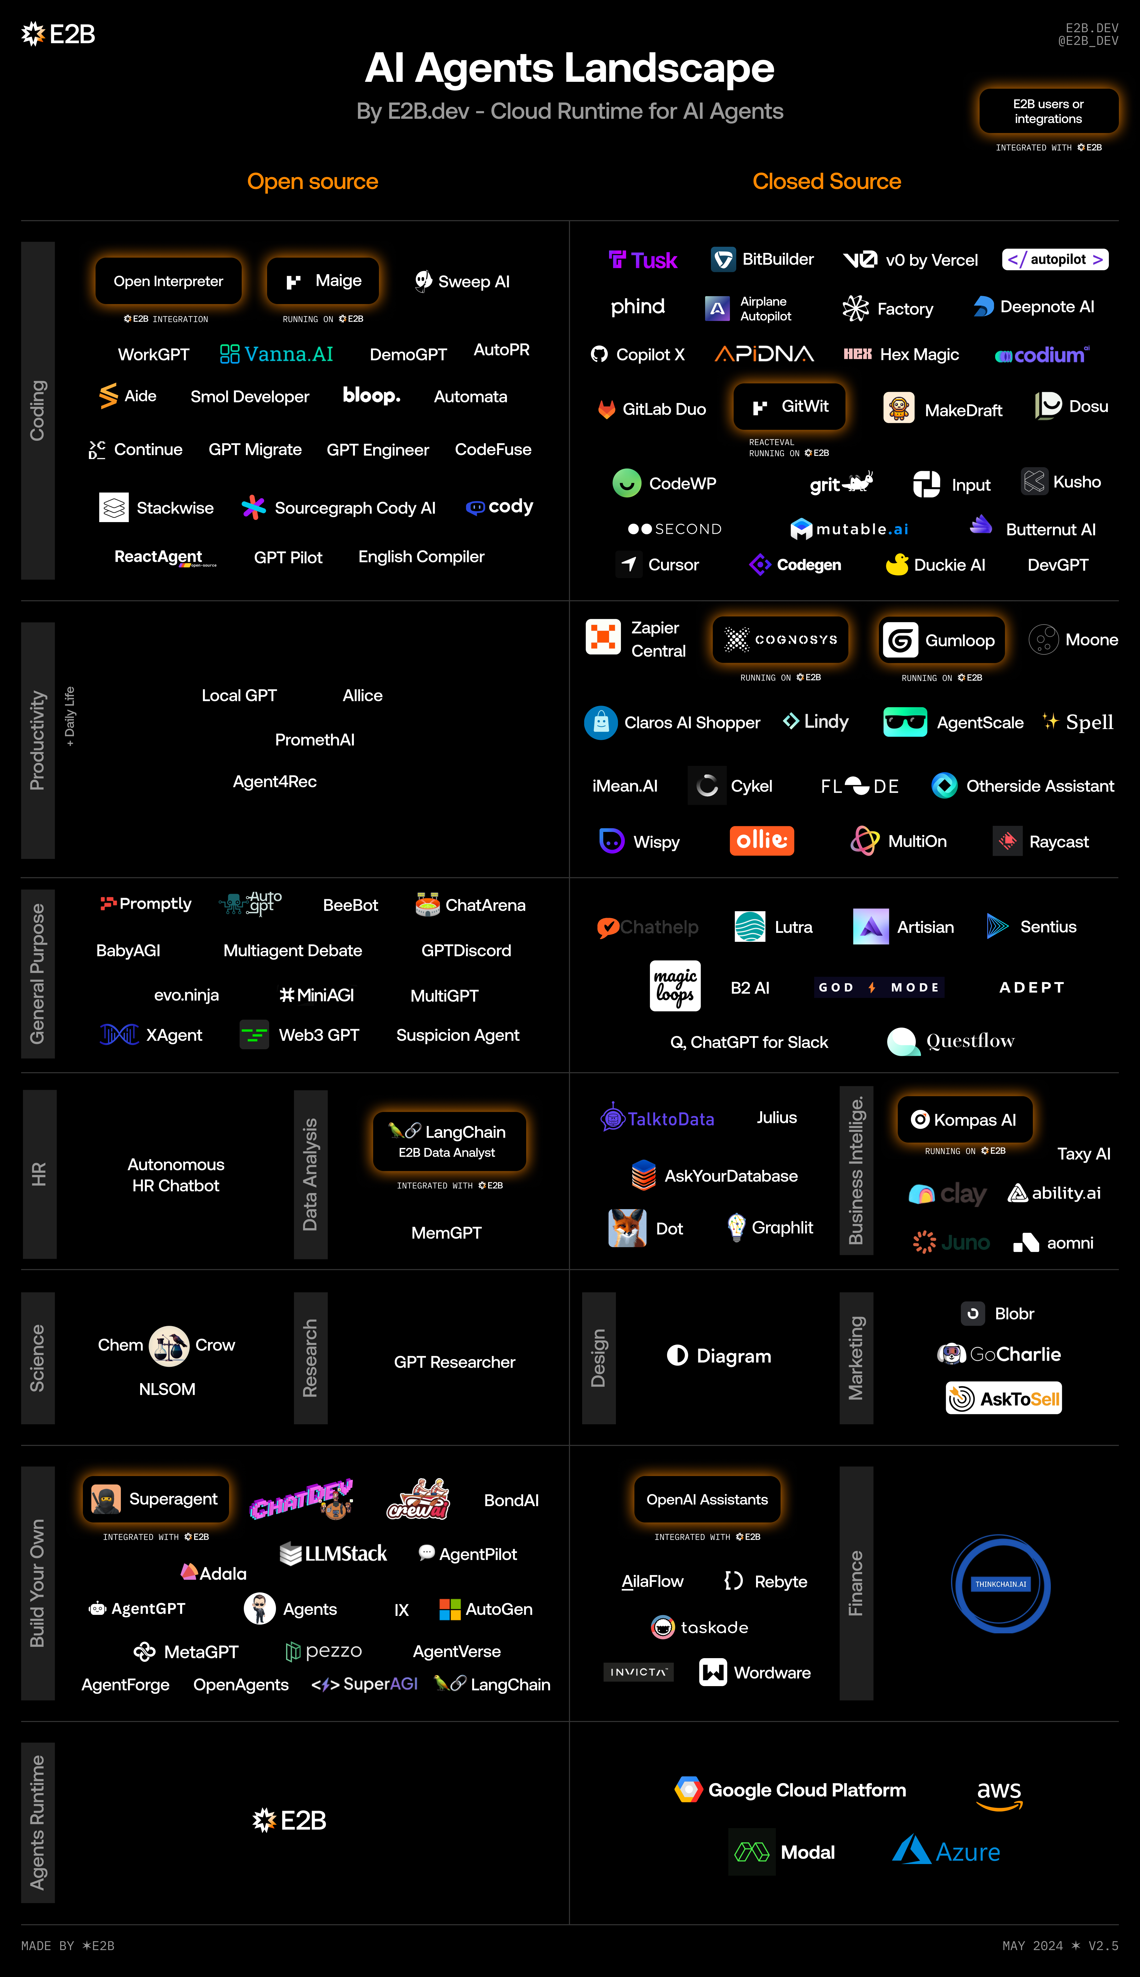

Slide 45
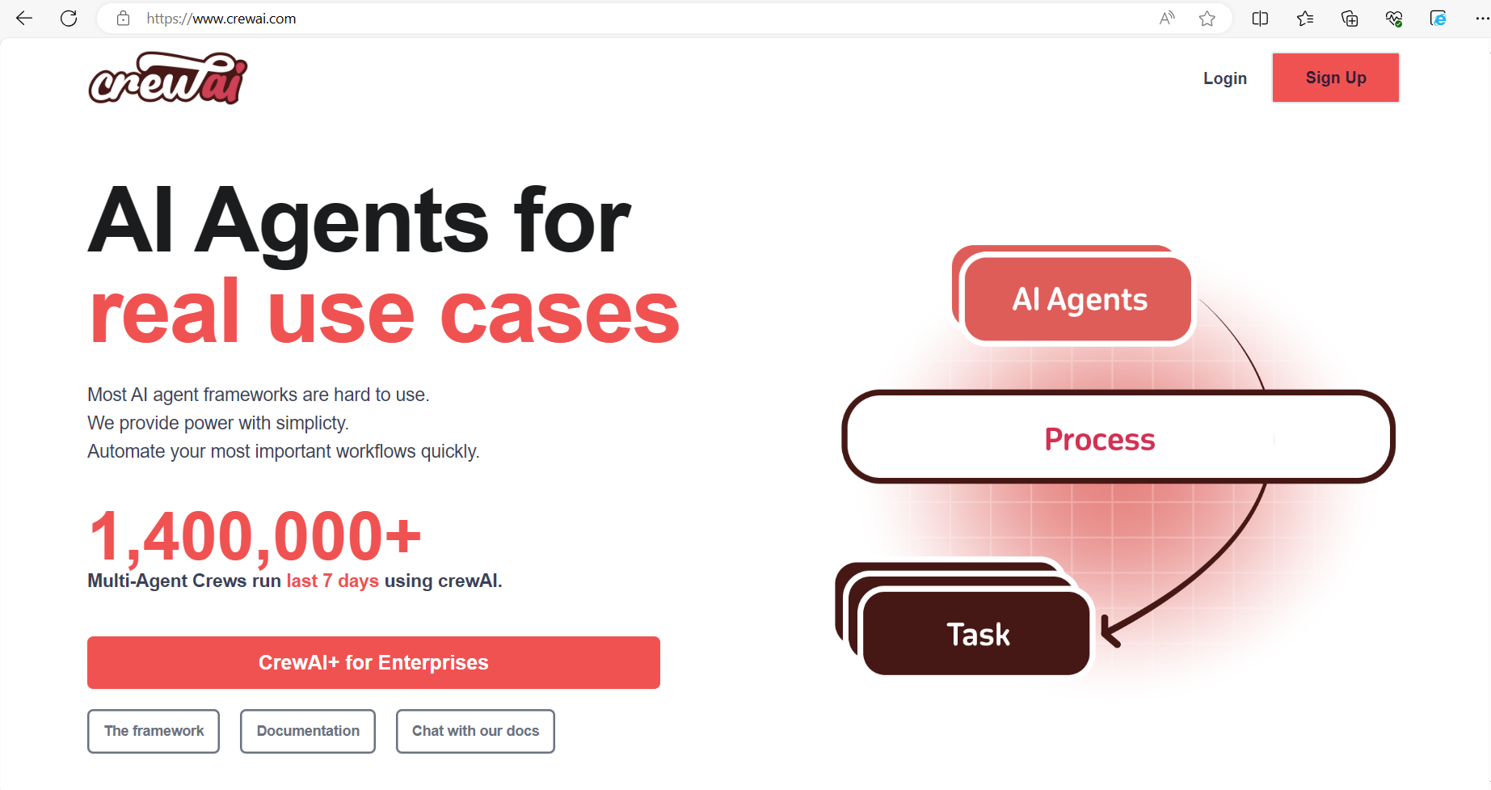

Slide 46
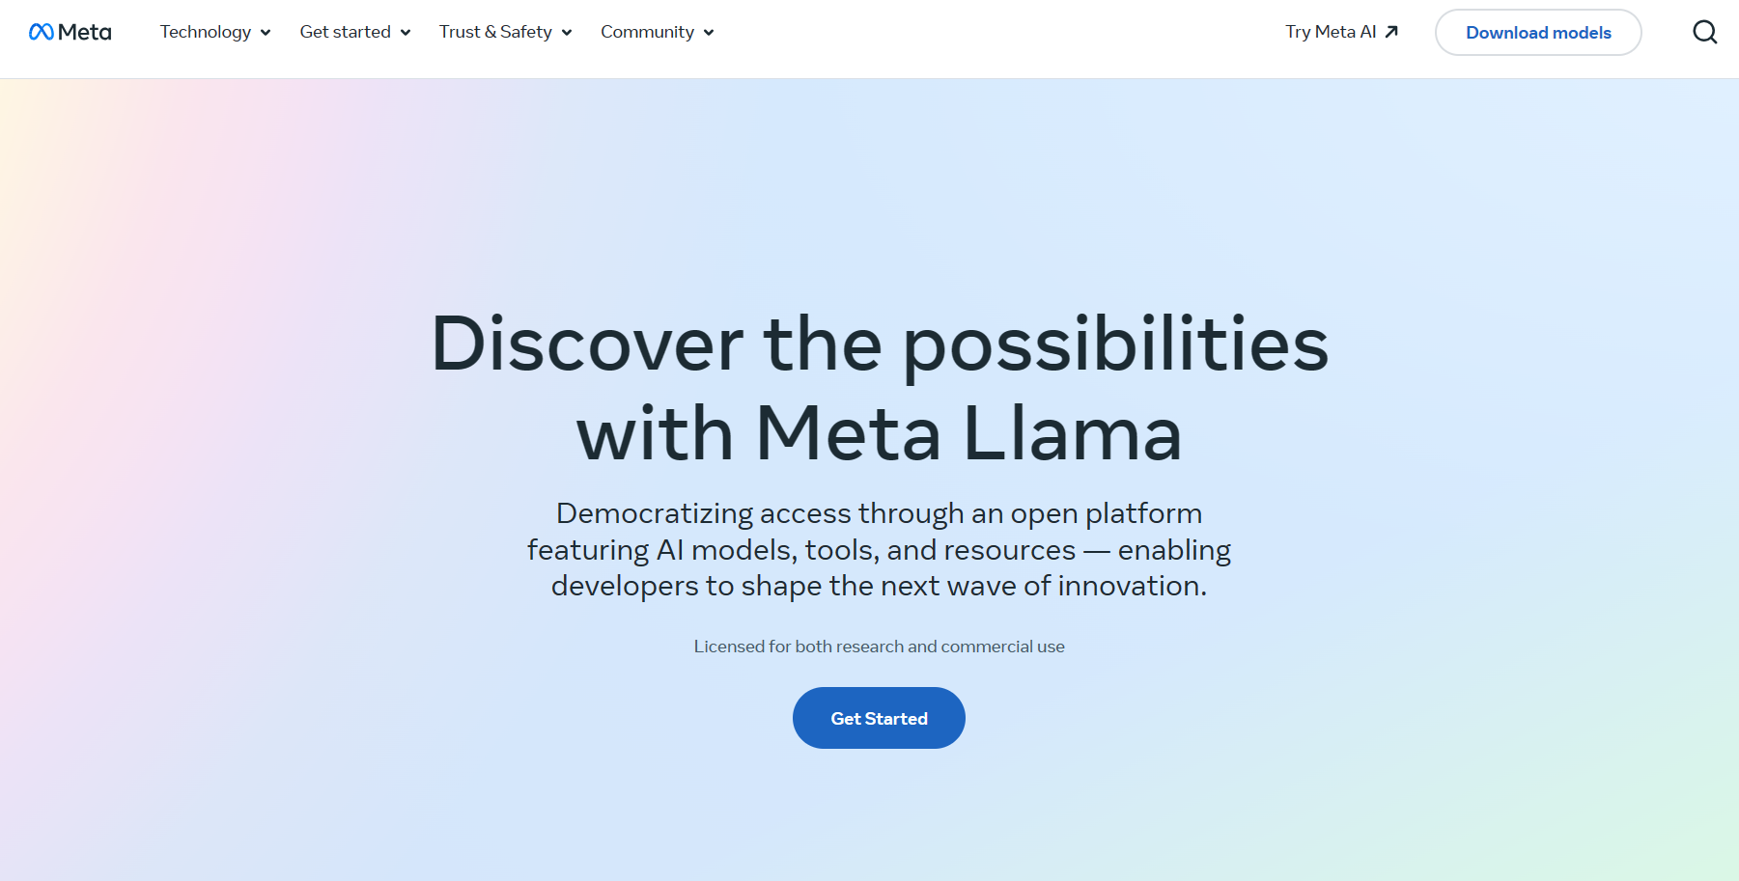

Slide 47
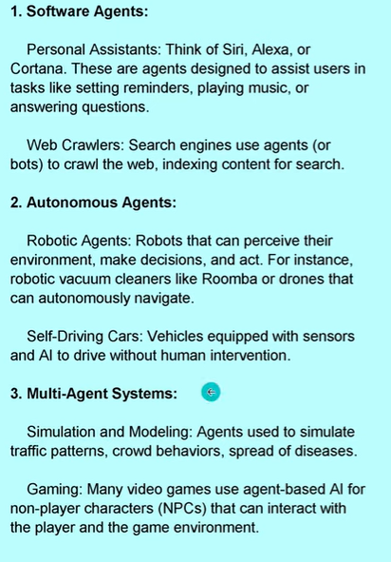
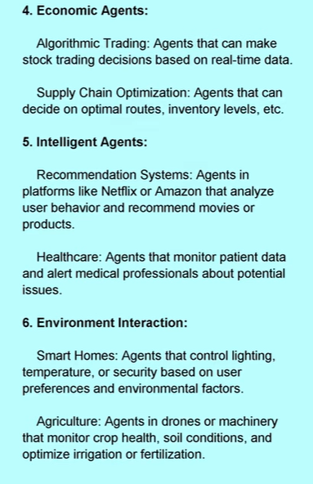
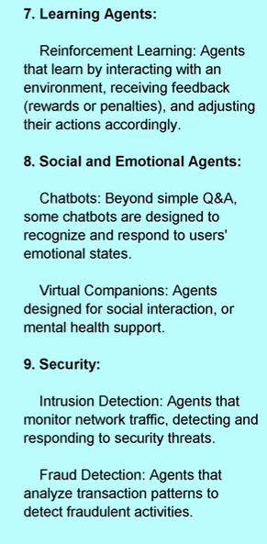

Slide 48
References
AI - Ch02 - Intelligent Agents (youtube.com)

Slide 49
Summary
What is Artificial Intelligence?
modeling humans thinking, acting, should think, should act.
History of AI
Intelligent agents
We want to build agents that act rationally
Real-World Applications of AI
AI is alive and well in various “every day” applications
many products, systems, have AI components

